Slide 1
Azure IoT Hands-On Labs

Slide 2









HOL Scenario
Power BI
Student machine
Stream Analytics
Email Notification
Storage BLOB
Simulator Sensor
(Node.js)
IoT Hub
Stream Analytics
Event Hub
Function App
Logic App
100 USD Azure Pass Credit for 30 days

Slide 3
01 - Get Free Email via Office 365 and Active Azure Trial

Slide 4
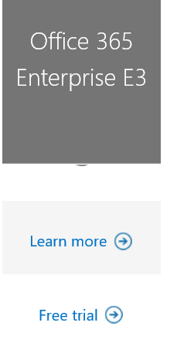
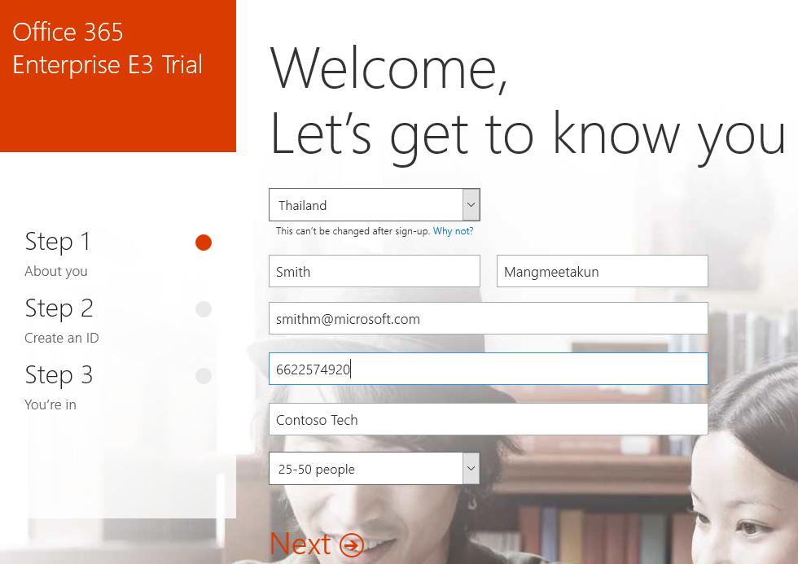
Get Free Email from Office 365 Trial
Step 1 : Define your own tenant name (yourtenantname): e.g. az816
Step 2 : Open http://aka.ms/o365plan and click Free trial
Step 3 : Follow the process to create trial tenant

Slide 5
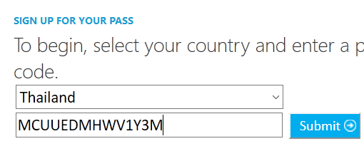
Get Azure Trial
Step 1 : Get Azure Pass Promo Code from Instructor
Step 2 : Open https://www.microsoftazurepass.com/
Step 3 : Select Thailand and Enter Promo Code then click Submit
Step 4 : Confirm information then click Submit
Step 5 : Confirm to use Azure Pass by click Active and Click Sign-up
Step 6 : Wait for service provisioning then click Start managing my service >

Slide 6
02 – Create Azure IoT Hub

Slide 7
HOL Scenario
Power BI
Student machine
Stream Analytics
Email Notification
Storage BLOB
Simulator Sensor
(Node.js)
IoT Hub
Stream Analytics
Event Hub
Function App
Logic App
100 USD Azure Pass Credit for 30 days

Slide 8
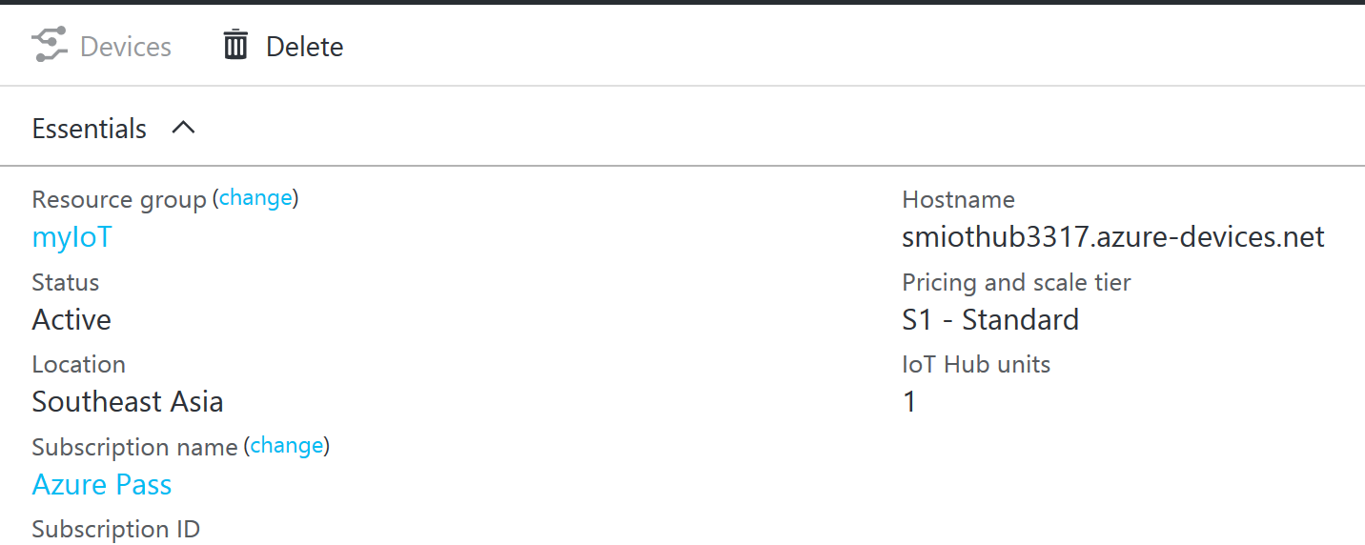
Create Azure IoT Hub
Logon to portal.azure.com then select New -> Internet of Things -> IoT hub
Enter following value
Name : xxx (unique value)
Pricing and scale tier : S1 – Standard
IoT Hub units : 1
Device-to-cloud partitions : 4
Resource group -> Create new : MyIoT
Location : Southeast Asia, click Ok
Click Create
Wait for 3-5 minutes until Azure IoT Hub provisioning completed (Hostname address must display as above image)

Slide 9
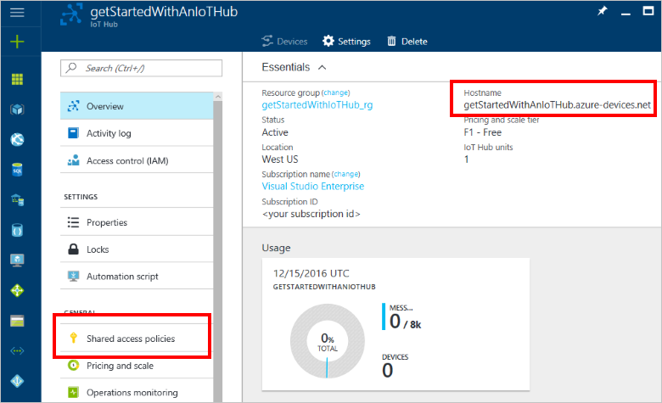
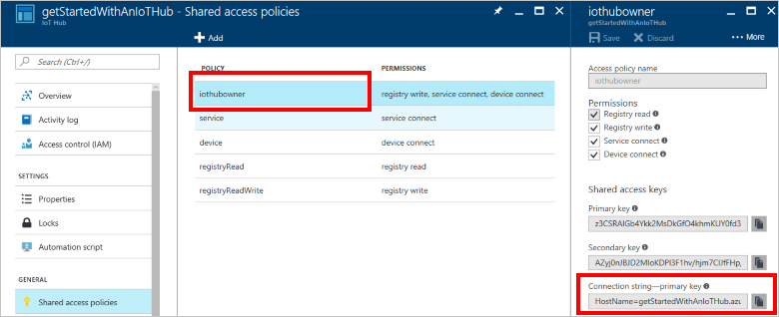
Get Connection String and Access Key
When the IoT hub has been created successfully, click the new tile for your IoT hub in the Azure portal to open the blade for the new IoT hub. Make a note of the Hostname, and then click Shared access policies.
In the Shared access policies blade, click the iothubowner policy, and then copy and make note of the IoT Hub connection string in the iothubowner blade.

Slide 10
Shared access policies
Host Name: <<Place your value here>>
Connection String: <<Place your value here>>
Primary Key: <<Place your value here>>
Example:
Host Name: smiothub3317.azure-devices.net
Connection String: HostName=smiothub3317.azure-devices.net;SharedAccessKeyName=iothubowner;SharedAccessKey=FOFL4P6AcuQu/GX8NS1euNWZy8qW8EnSPttbspVozs4=
Primary Key: FOFL4P6AcuQu/GX8NS1euNWZy8qW8EnSPttbspVozs4=

Slide 11
03 – Create Simulated Device

Slide 12
HOL Scenario
Power BI
Student machine
Stream Analytics
Email Notification
Storage BLOB
Simulator Sensor
(Node.js)
IoT Hub
Stream Analytics
Event Hub
Function App
Logic App
100 USD Azure Pass Credit for 30 days

Slide 13
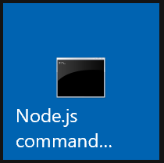
npm install azure-iothub --save
Create Simulated Device
Download Node.js Installer from https://nodejs.org/en/download/ (Choose Windows 64 bits) and install in local machine
Once installer finished, open Node.Js command prompt
Create new folder by type command “md c:\iotsim”, then type cd c:\iotsim” (warning: case sensitive)
Create new folder by type command “md createdevice”, then type “cd createdevice”
Create a package.json file using the following command “npm init” at your command prompt. Accept all the defaults:
Run the following command “npm install azure-iothub --save” to install the azure-iothub Service SDK package
Copy source code from https://github.com/SmithMMTK/IoT-Bootcamp/blob/master/Source%20code/Simulated%20Device/Create%20Device.js and put into file c:\iotsim\createdevice\createdevice.js

Slide 14
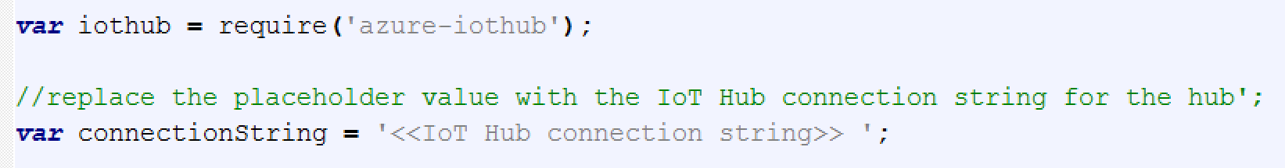

Create Simulated Device (cont.)
Open the createdevice.js file and replace the placeholder value with the <<IoT Hub connection string>> for the hub you created in the previous section
To run the createdevice application, execute the following command at the command prompt in the createdevice folder “node createdevice.js”
Make a note of the Device ID and Device key. You need these values later when you create an application that connects to IoT Hub as a device.
Switch back to Azure IoT Hub in Azure Portal, click Devices
Click Device name you just create by script, then copy and make note of the Device connection string

Slide 15
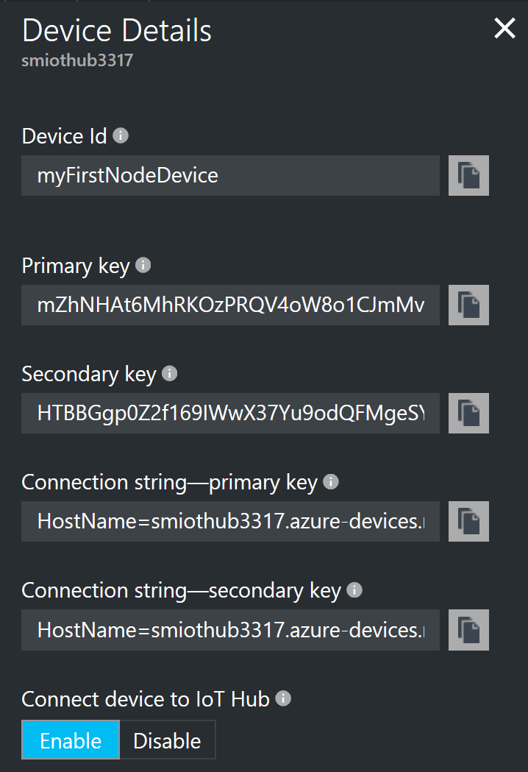
Device Details
Device Id: <<Place your value here>>
Primary key: <<Place your value here>>
Connection string: <<Place your value here>>
Example:
Device Id: myFirstNodeDevice
Primary key: mZhNHAt6MhRKOzPRQV4oW8o1CJmMvMpIe4fpMIE/Ij4=
Connection string: HostName=smiothub3317.azure-devices.net;DeviceId=myFirstNodeDevice;SharedAccessKey=mZhNHAt6MhRKOzPRQV4oW8o1CJmMvMpIe4fpMIE/Ij4=

Slide 16
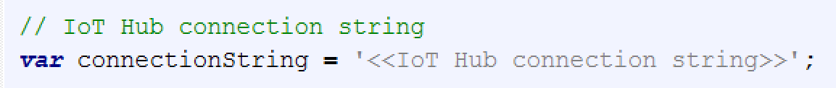
Create Receive device-to-cloud messages appliction
Create new folder c:\iotsim\readdevice” and open Node.js command at created folder
Create a package.json file using the following command “npm init” at your command prompt. Accept all the defaults:
Run the following command “npm install azure-event-hubs --save” to install the azure-event-hubs
Copy source code from https://github.com/SmithMMTK/IoT-Bootcamp/blob/master/Source%20code/Simulated%20Device/Read%20Device%20Information.js and put into file c:\iotsim\readdevice\readdevice.js
Open the readdevice.js file and replace the placeholder value with the <<IoT Hub connection string>> for the hub you created in the previous section

Slide 17
Create a simulated device application
Create new folder c:\iotsim\senddata” and open Node.js command at created folder
Create a package.json file using the following command “npm init” at your command prompt. Accept all the defaults:
Run the following command “npm install azure-iot-device azure-iot-device-mqtt --save” to install the azure-iot-device-mqtt
Copy source code from https://github.com/SmithMMTK/IoT-Bootcamp/blob/master/Source%20code/Simulated%20Device/Send%20Device%20Telemetry.js and put into file c:\iotsim\senddata\senddata.js
Open the senddata.js file and replace the placeholder value with the <<IoT Device connection string>> for the hub you created in the previous section
Run the senddata.js and readdevice.js application, execute the following command at the command prompt in the createdevice folder “node createdevice.js” “node readdevice.js”

Slide 18
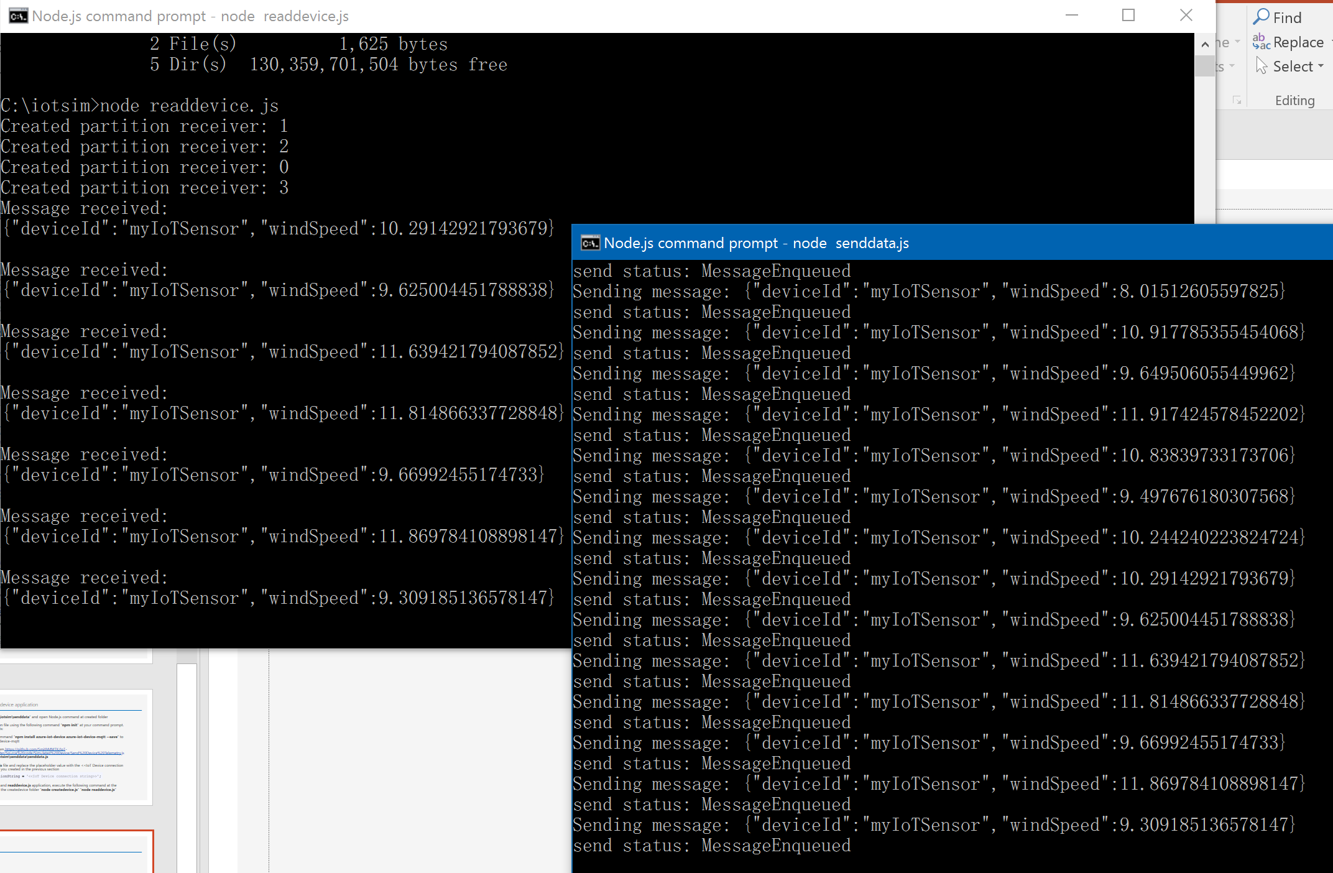
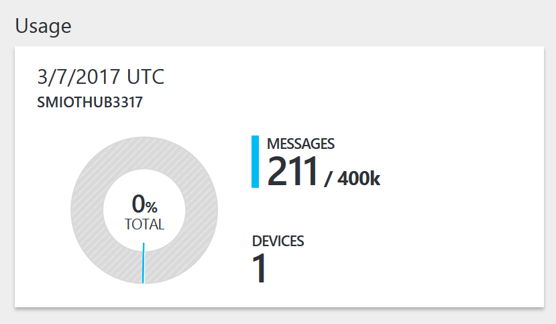
Verified Device to Cloud Data
Check command prompt status
Open Azure IoT Hub and check Usage data

Slide 19
04 - Process IoT streaming data

Slide 20
HOL Scenario
Power BI
Student machine
Stream Analytics
Email Notification
Storage BLOB
Simulator Sensor
(Node.js)
IoT Hub
Stream Analytics
Event Hub
Function App
Logic App
100 USD Azure Pass Credit for 30 days

Slide 21
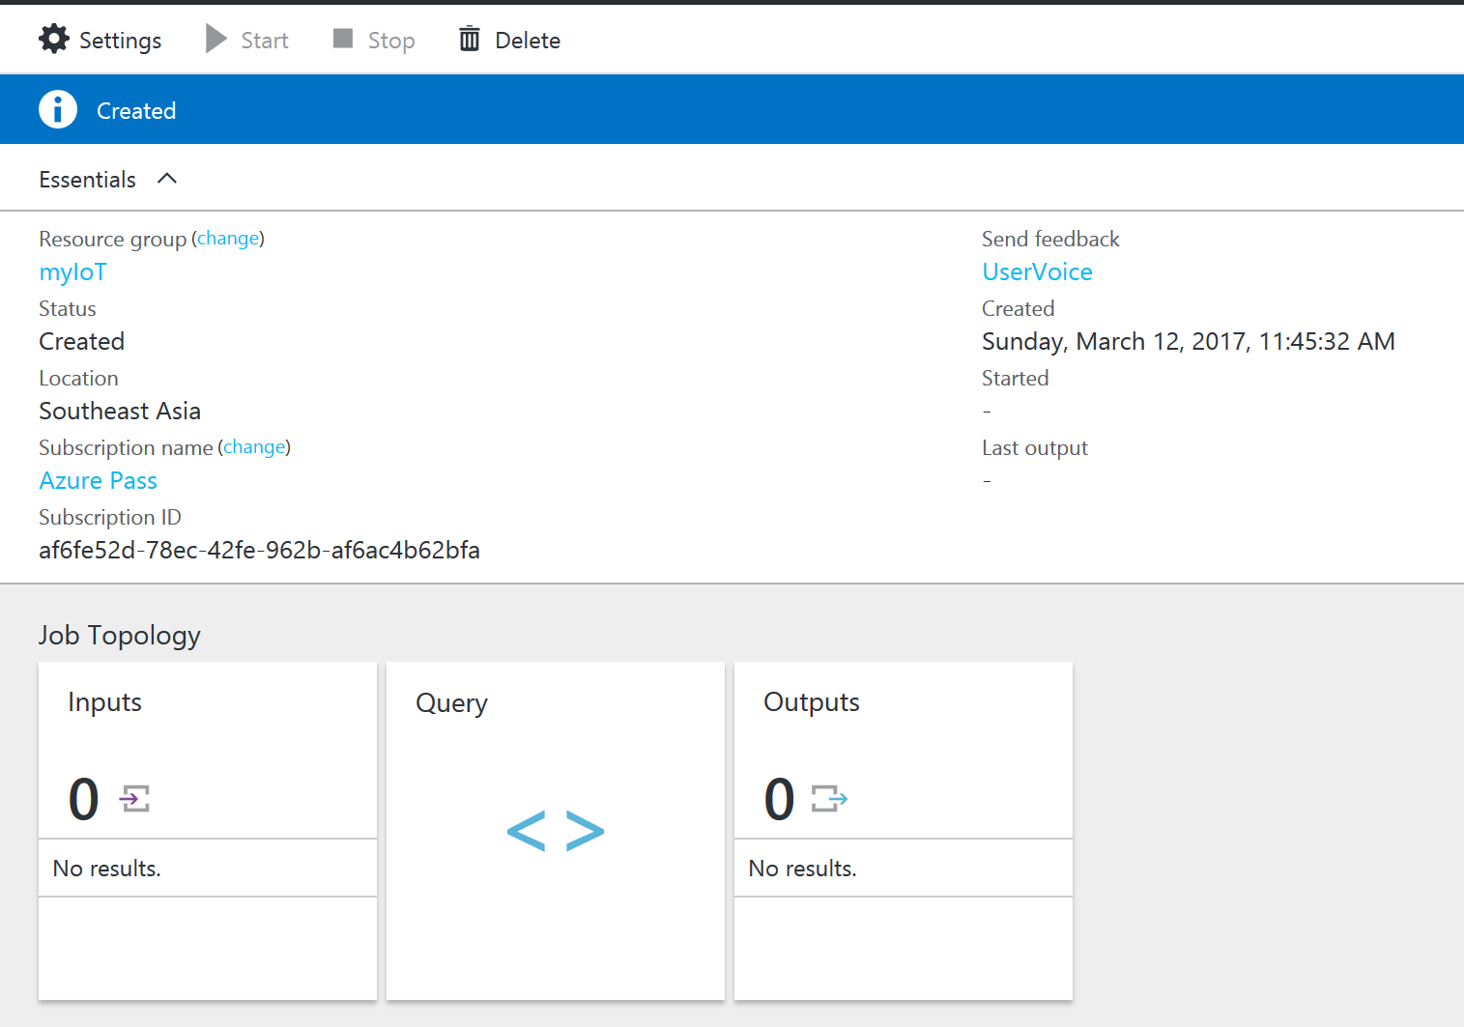
Create Azure Stream Analytics
Logon to portal.azure.com then select New -> Internet of Things -> New Stream Analytics Job
Enter following value
Job name : SA01
Resource group -> Use existing : MyIoT
Location : Southeast Asia, click Ok
Click Create
Once Stream Analytics Job was created, click to open SA01 Stream Analytics Job

Slide 22
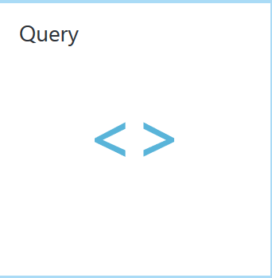
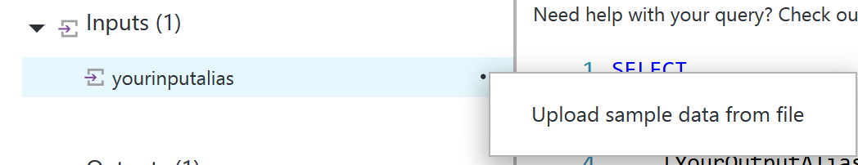

Create an first Azure Stream Analytics query
In the Job Topology pane click the Query box to go to the Query Editor. The QUERY editor allows you to enter a T-SQL query that performs the transformation over the incoming event data.
Review default code from query panel
Download example IoT Simulated Sensors from https://github.com/SmithMMTK/IoT-Bootcamp/blob/master/Source%20code/Stream%20Analytics/windSpeed.json
Click the three dots next to your input and select Upload sample data from file box.
A pane opens on the right as a result, in it select the windSpeed.json data file from your downloaded location and click OK at the bottom of the pane.
Then click the Test gear in the top left area of the window and process your test query against the sample dataset. A results window will open below your query as the processing is complete.

Slide 23
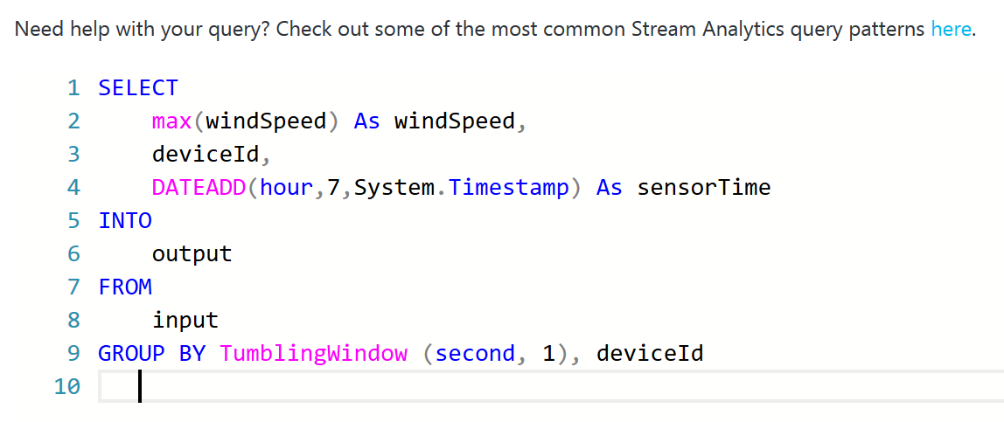

Modified an Azure Stream Analytics query
Download query from https://github.com/SmithMMTK/IoT-Bootcamp/blob/master/Source%20code/Stream%20Analytics/01%20Basic%20Query.txt
Paste query into Query Editor
Click the three dots next to your input and select Upload sample data from file box.
A pane opens on the right as a result, in it select the windSpeed.json data file from your downloaded location and click OK at the bottom of the pane.
Then click the Test gear in the top left area of the window and process your test query against the sample dataset. A results window will open below your query as the processing is complete.
Click Save button to save your Query
Note: How many result return from this query?

Slide 24
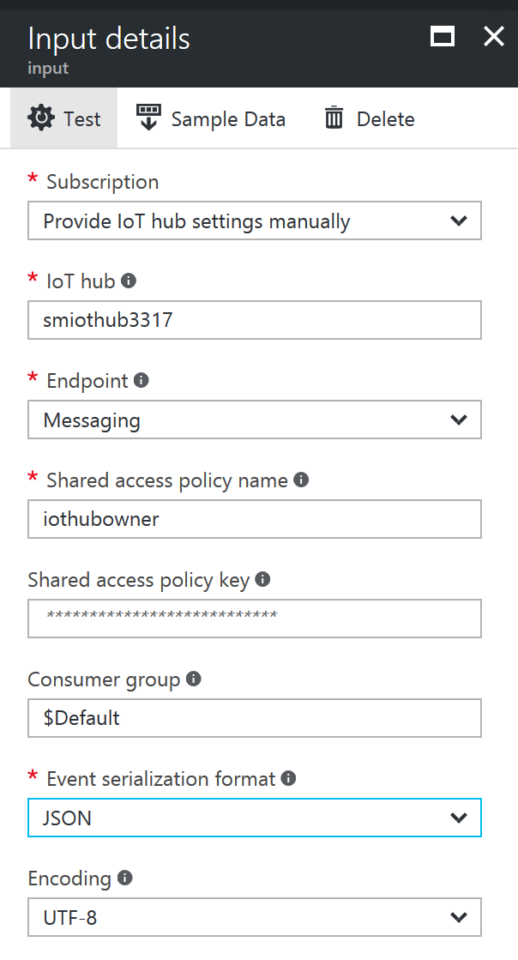
Connect Azure Stream Analytics to receive data from Azure IoT Hub
In the Job Topology pane click the Inputs box to go to Inputs blade.
Click + Add to add new Stream Analytics Input by enter following parameter
Input alias: input
Source Type: Data stream
Source: IoT Hub
IoT Hub: IoT Hub name you just create recently
Review auto-filling parameters then click Create

Slide 25
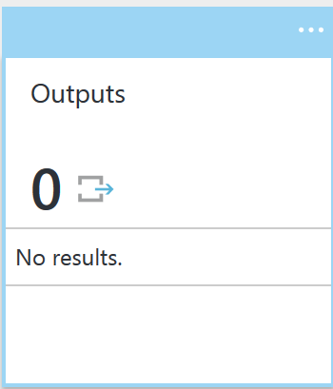
Send Stream Analytics Output to PowerBI
Open new Tab in same browser session then go to https://powerbi.com
Click Sign in then click Sign in to connect current Office 365 account to Power BI.
Once system prompt to enter password then click Start -> button, wait until you got Send Invitations page, click Skip
Switch back on Azure Tab in same browser session then go to Steam Analytics blade then click Outputs
Click + Add to add new Stream Analytics Output by enter following parameter
Output alias: output
Sink: Power BI
Click Authorize button then enter your Office 365 User Name & Password
Dataset Name: IoT Hub Sensors
Table Name: Wind Sensors then click Create

Slide 26
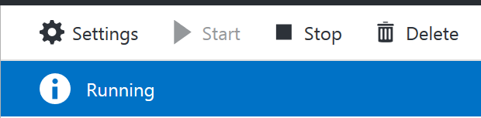
Send Stream Analytics Output to PowerBI (cont.)
Ensure your simulated device still running
Close Output page to go back to Steam Analytics Job Topology, then click Start button
In Job output start time, select Now then click Start
Wait until Job status is change from Starting to Running

Slide 27
05 - Display Sensors Data in PowerBI

Slide 28
HOL Scenario
Power BI
Student machine
Stream Analytics
Email Notification
Storage BLOB
Simulator Sensor
(Node.js)
IoT Hub
Stream Analytics
Event Hub
Function App
Logic App
100 USD Azure Pass Credit for 30 days

Slide 29
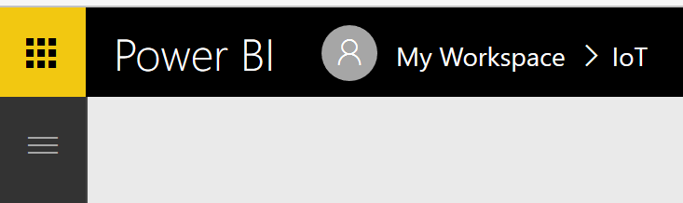


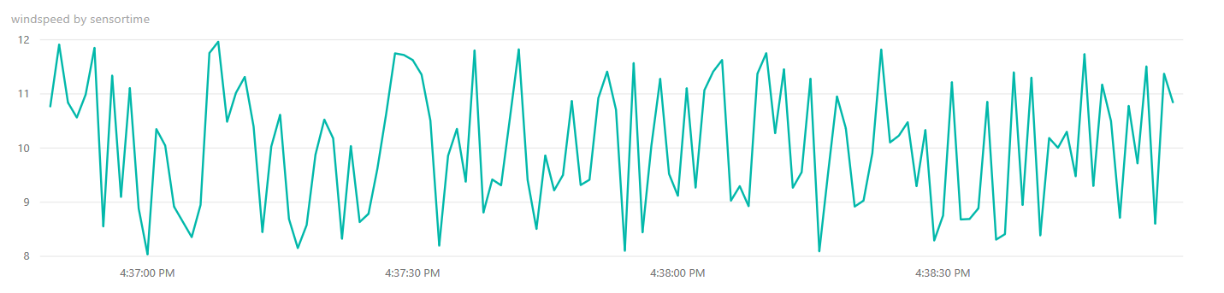
Create First Reports from Steaming datasets
Switch to Power BIT Tab from your web browser
Click Show the navigation pane (left top corner)
In Datasets session click Steaming datasets
Your dataset from previous step will show in this section
Click Create report button
Once new report page display, In Fields pane (Right pane), select fields: sensortime, windspeed
Select Line Chart in Visualizations area
Adjust width and height of report data

Slide 30
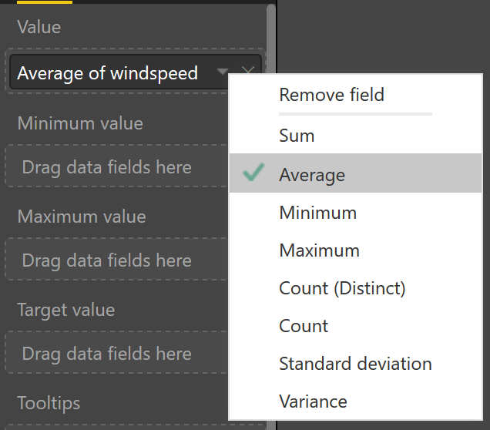


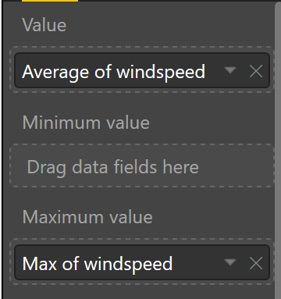

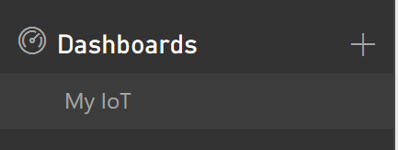
Create New Item in Reports from Steaming datasets
Click any empty area (white area), then select windspeed field
Select Gauge in Visualizations area
In Value pane, select windspeed by click to show drop down then select Average
In Maximum value, drag and drop field windspeed then select Maximum
Click Save report, then enter your report name and click Save
Pin your new chart into Dashboard by click Pin visual (top right corner of your chart)
In Pin to dashboard windows, select New dashboard then type your dashboard name then click Pin.
Go to your Dashboards by click Dashboard navigation (Left panel)
Explore your Live Data from IoT Sensor
Note: You can adjust value in your source code and see how reflect to your report

Slide 31
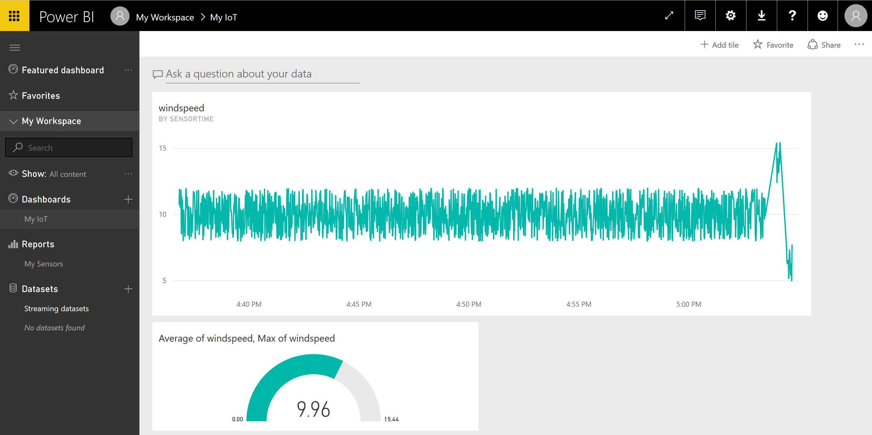

Slide 32
06 - Store Sensor Data in BLOB Storage

Slide 33
HOL Scenario
Power BI
Student machine
Stream Analytics
Email Notification
Storage BLOB
Simulator Sensor
(Node.js)
IoT Hub
Stream Analytics
Event Hub
Function App
Logic App
100 USD Azure Pass Credit for 30 days

Slide 34
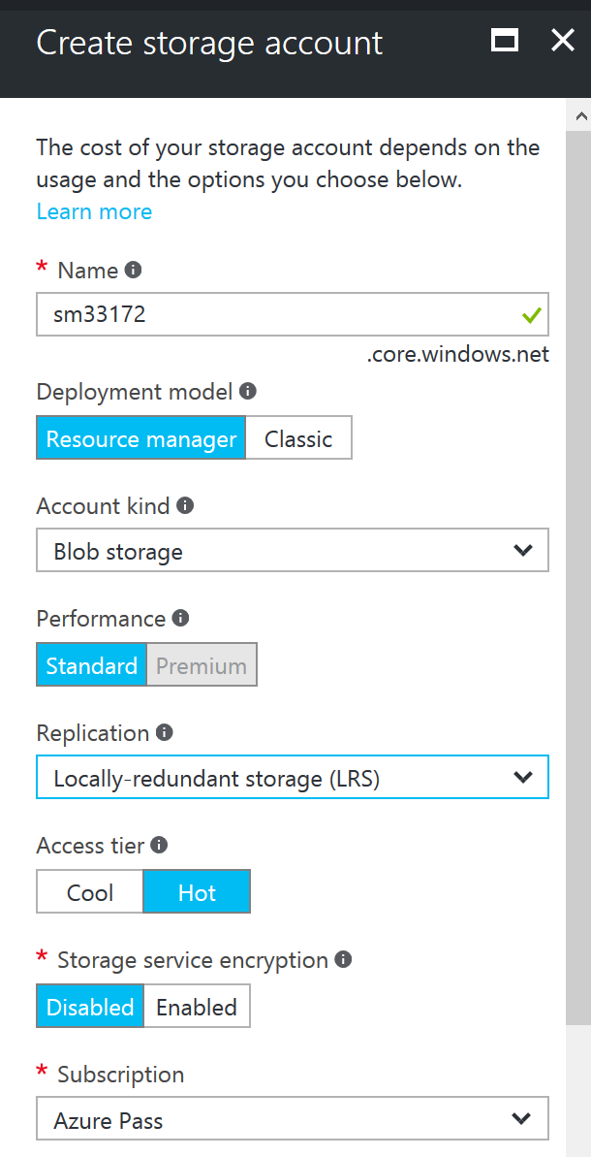
Create Azure Storage Account
Logon to portal.azure.com then select New -> Storage -> Storage Account
Enter following value
Name: xxx (unique value)
Account kind: Blob storage
Replication: Locally-redundant storage (LRS)
Resource group: Use existing -> Your IoT Resource Group
Location : Southeast Asia, click Create
Click Create

Slide 35

Add New Output to Stream Analytics
In the Job Topology pane click Stop button (then confirm to Stop the job), In The Job Topology click Outputs
Click + Add to add new Stream Analytics Output by enter following parameter
Output alias: output2
Sink: Blob storage
Storage account: Your Storage Account that created in previous step
Container: Create a new container -> myiotsensor
Path pattern: sensor/logs/{date}
Click Create
Switch back to Job Topology pane click Query and append following query https://github.com/SmithMMTK/IoT-Bootcamp/blob/master/Source%20code/Stream%20Analytics/02%20Basic%20Query.txt
Click Save query, then click Start Stream Analytics Jobs

Slide 36

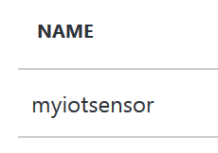
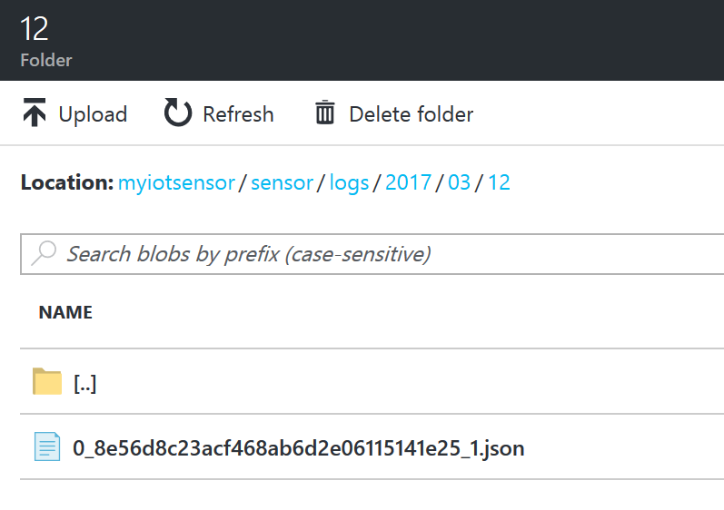
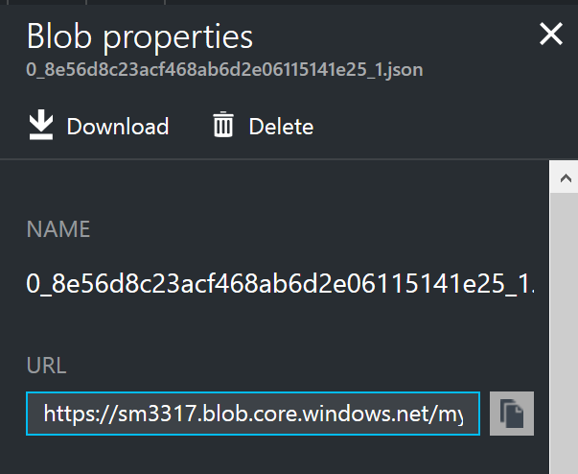
Review IoT Sensor data from Blob Storage Account
Switch Azure Resource Group, then Click Storage Account you created in previous steps
In Storage panel, click container myiotsensor
Explore .json file that generated from Stream Analytics Jobs
Once you select one of .json file, Blob properties panel will display.

Slide 37
07 - Alert to trigger a business workflow

Slide 38
HOL Scenario
Power BI
Student machine
Stream Analytics
Email Notification
Storage BLOB
Simulator Sensor
(Node.js)
IoT Hub
Stream Analytics
Event Hub
Function App
Logic App
100 USD Azure Pass Credit for 30 days

Slide 39

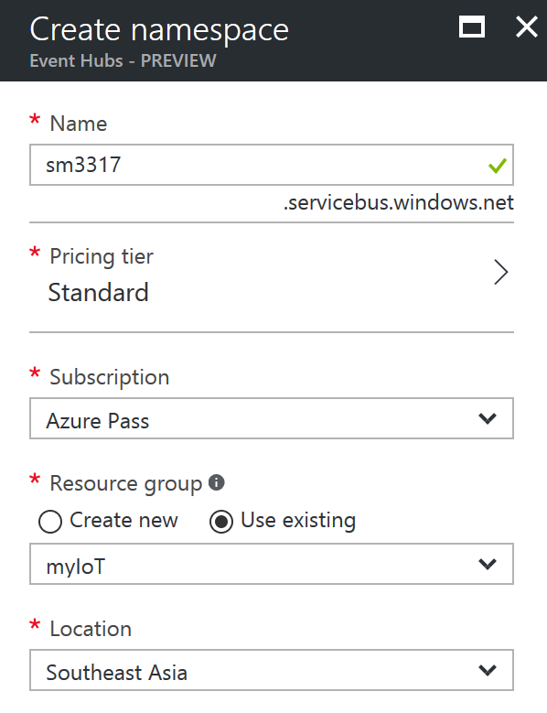

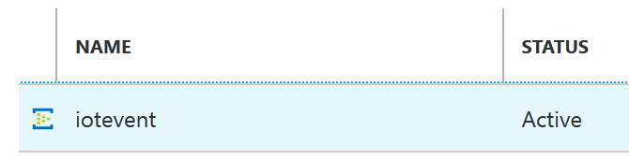
Create Azure Event Hub
Logon to portal.azure.com then select New -> Internet of Things -> Event Hubs
Enter following value
Name: xxx (unique value)
Resource group: Use existing -> Your IoT Resource Group
Location : Southeast Asia, click Create
Click Create, then click Event Hub
Click + Event Hub to add new Event Hub with following parameter
Name: iotevent
Leave all default value then click Create

Slide 40
Create Azure Stream Analytics
Logon to portal.azure.com then select New -> Internet of Things -> New Stream Analytics Job
Enter following value
Job name : SA02
Resource group -> Use existing : MyIoT
Location : Southeast Asia, click Ok
Click Create
Once Stream Analytics Job was created, click to open SA02 Stream Analytics Job

Slide 41
Connect Azure Stream Analytics to receive data from Azure IoT Hub
In the Job Topology pane click the Inputs box to go to Inputs blade.
Click + Add to add new Stream Analytics Input by enter following parameter
Input alias: input
Source Type: Data stream
Source: IoT Hub
IoT Hub: IoT Hub name you just create recently
Review auto-filling parameters then click Create

Slide 42
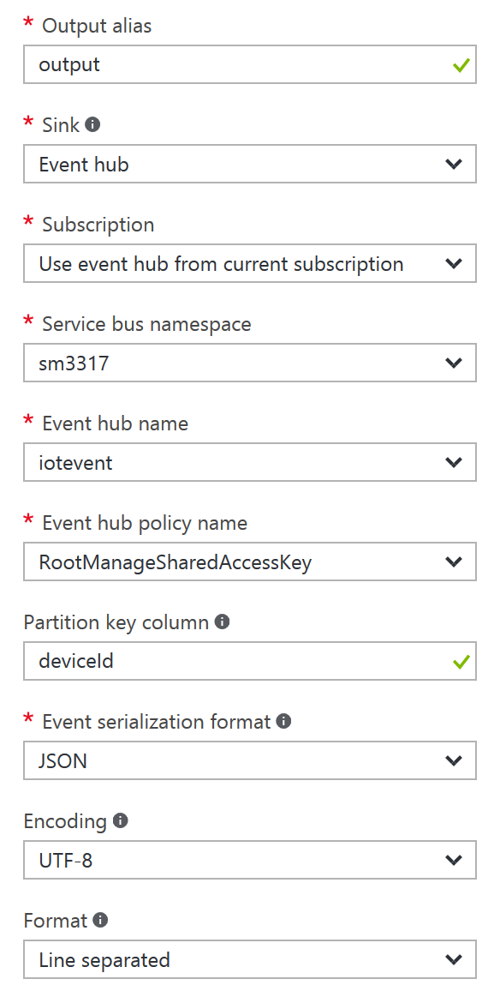
Send Stream Analytics Output to Event Hub
Go to Steam Analytics blade then click Outputs
Click + Add to add new Stream Analytics Output by enter following parameter
Output alias: output
Sink: Event hub
Service hub namespace: your service hub
Event hub name: iotevent
Partition key column: deviceId
Click Create

Slide 43
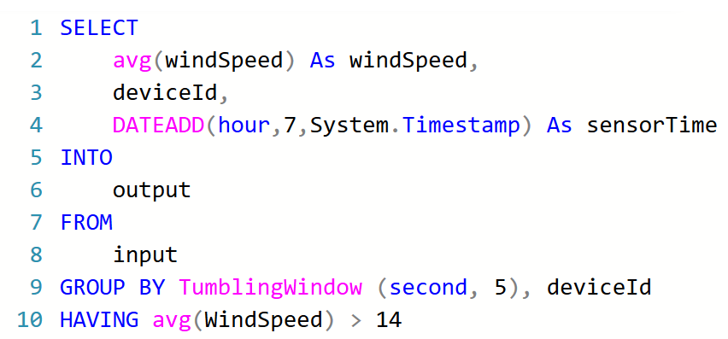
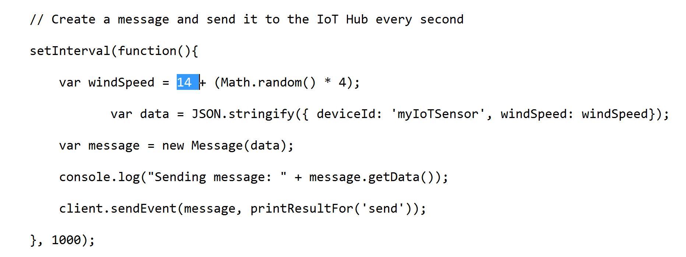
Modified an Azure Stream Analytics query
Download query from https://github.com/SmithMMTK/IoT-Bootcamp/blob/master/Source%20code/Stream%20Analytics/03%20Alert%20to%20trigger%20a%20business%20workflow.txt
Paste query into Query Editor
Click Save button, then click Start Stream Analytics Jobs
Edit Senddata.txt (detail step in 03 - Create Simulated Device) to change WindSpeed from 8 to 14 then save and run senddata.js

Slide 44

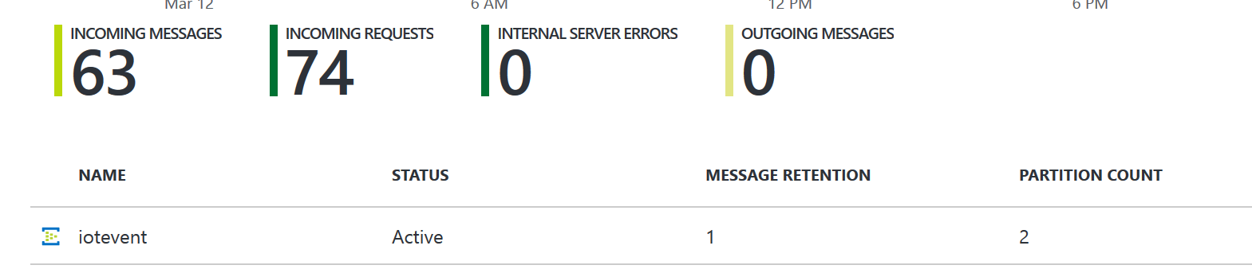


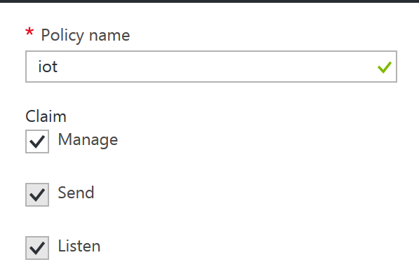
Get Event Hub Connection String
Open Event Hub
Click Event Hub: iotevent
Click Shared access policies
Click + Add
Enter policy name: iot, click Create
Click new create policy then take note on:
Primary Key:
Your Key
Connection String-Primary Key:
Your key

Slide 45
08 - Create an Azure function to process the Event hub queue

Slide 46
HOL Scenario
Power BI
Student machine
Stream Analytics
Email Notification
Storage BLOB
Simulator Sensor
(Node.js)
IoT Hub
Stream Analytics
Event Hub
Function App
Logic App
100 USD Azure Pass Credit for 30 days

Slide 47
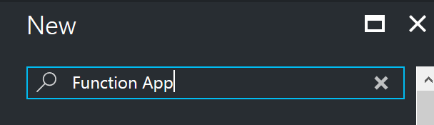



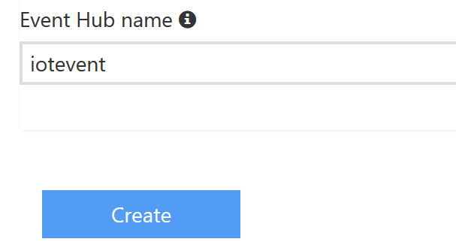
Create Azure Function App
Logon to portal.azure.com then select New type Function App then press Enter
Select Function App then click Create, then Enter following value
App Name: xxx (unique value)
Resource Group: Your IoT Resource Group
Hosting Plan: Consumption Plan
Location: Southeast Asia, then click Create
Click your new created function app
Click + New Function > EventHubTrigger – C# > Create
In Event Hub connection, click new, then click Add a connection string Enter your connection and connection string
Change Event Hub Name iotevent then Click Create

Slide 48

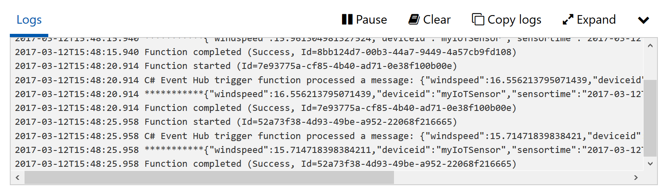
Process Event from Event Hub in Azure Function App
Download source code from https://github.com/SmithMMTK/IoT-Bootcamp/blob/master/Source%20code/Function%20App/eventHubFx.txt then paste code to replace all default code
Click Save and run
Review result from Logs section
Click Pause to continue edit code

Slide 49

Create Azure Logic App
Logon to portal.azure.com then select New -> Web + Mobile -> Logic App
Select Logic App then click Create, then Enter following value
App Name: LogicApp
Resource Group: Your IoT Resource Group
Hosting Plan: Consumption Plan
Location: Southeast Asia, then click Create
Click your new created Logic App

Slide 50
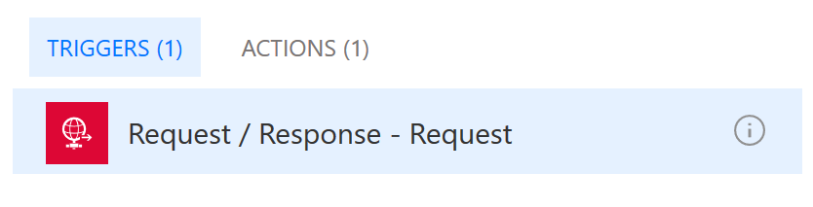

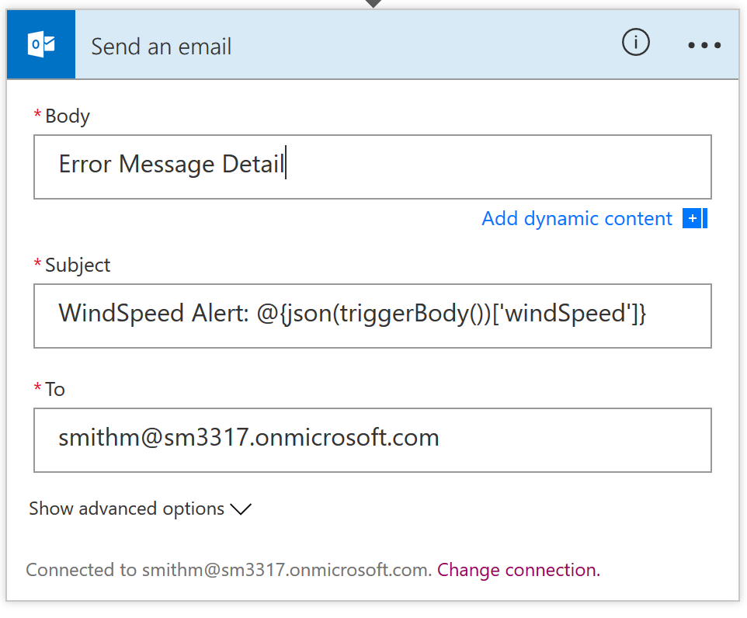
Building Logic App Solution
Select Blank Logic App
Click Request / Response then select TRIGGERS
Click Use sample payload to generate schema
Download sample payload from windSpeed.json at and paste into code area then click DONE.
Click + New Step, then select Add an action
Type Office 365 Outlook send an email in query then click Office 365 Outlook – Send an email
Click Sign In and enter your credential
Enter following parameter
To: Your target mail
Subject: WindSpeed Alert: @{json(triggerBody())['windSpeed']}

Slide 51
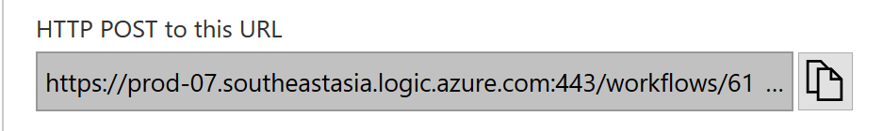

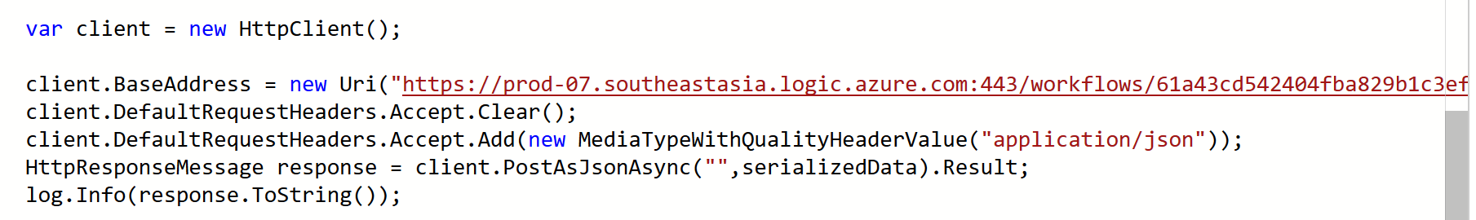
Building Logic App Solution (cont.)
Click Save then copy HTTP POST from Request Action
Place your url here: <<your URL>>
Click Run
Switch to Azure Function App, select your EventHubTrigger
Go to line 54, replease “API URL” with Log App URL
Remove comment “//” from the source code then click Save and Run
Switch to Logic App and see the results

